Slide 1

TrumpTweets.Project3
Prepared By:
Edward Doris
Hailu Sefera
Taiwo Onitiri

Slide 2
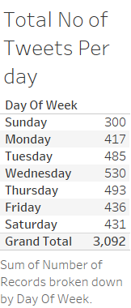

Slide 3
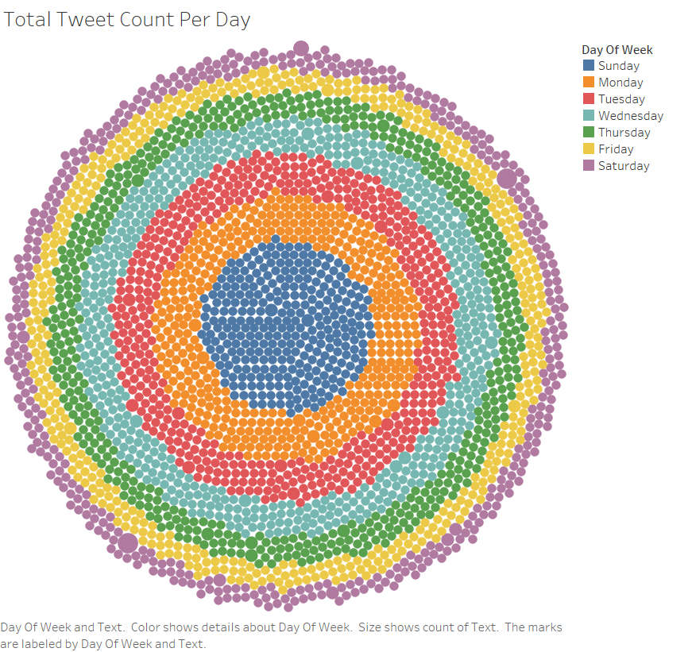

Slide 4
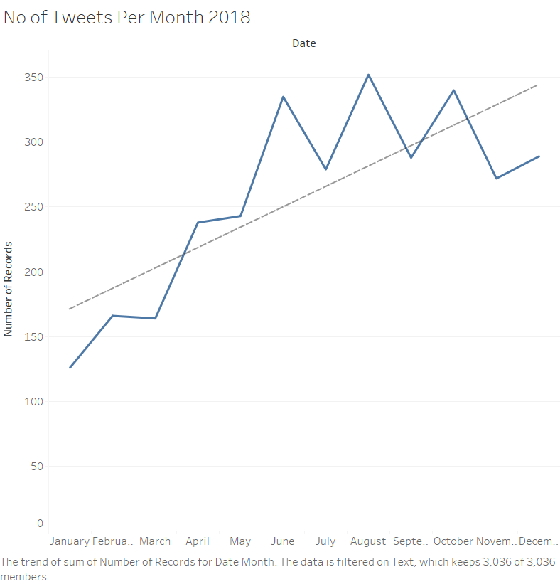
Notes:
Trend Lines Model
A linear trend model is computed for sum of Number of Records given Date Month. The model may be significant at p <= 0.05.
Model formula:
( Month of Date + intercept )
Number of modeled observations:
12
Number of filtered observations:
0
Model degrees of freedom:
2
Residual degrees of freedom (DF):
10
SSE (sum squared error):
23932.6
MSE (mean squared error):
2393.26
R-Squared:
0.596651
Standard error:
48.9209
p-value (significance):
0.0032328
Individual trend lines:
Panes
Line
Coefficients
Row
Column
p-value
DF
Term
Value
StdErr
t-value
p-value
Number of Records
Month of Date
0.0032328
10
Month of Date
15.7343
4.09097
3.84609
0.0032328
intercept
155.394
30.1087
5.16109
0.0004246

Slide 5
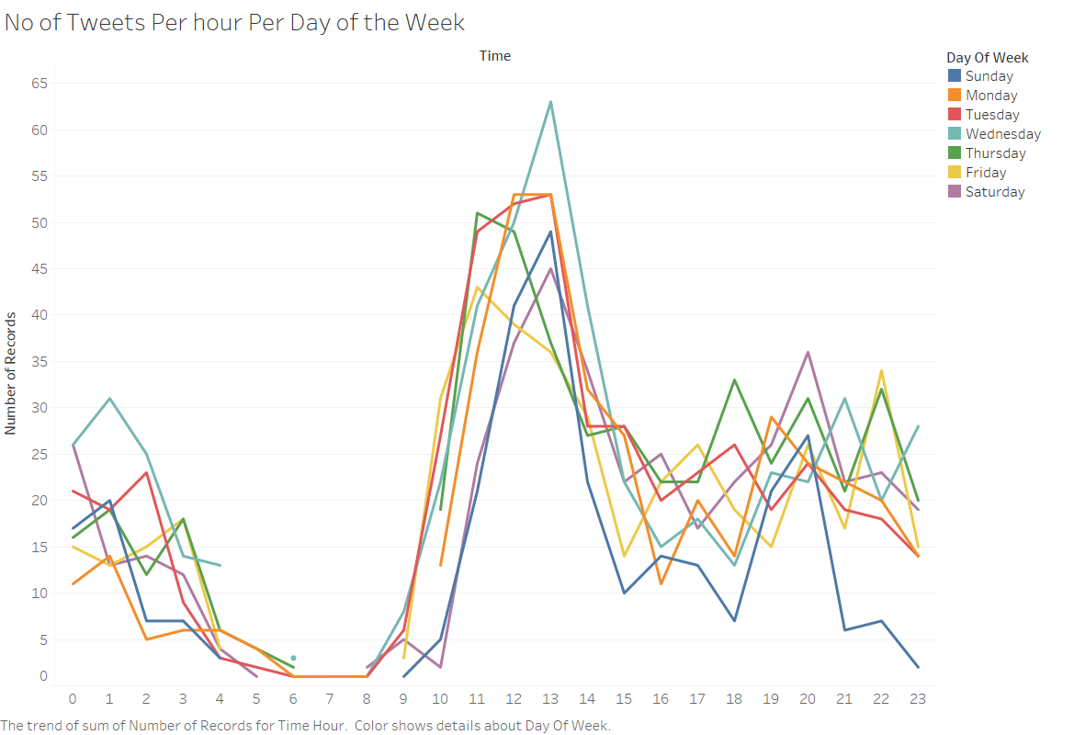

Slide 6
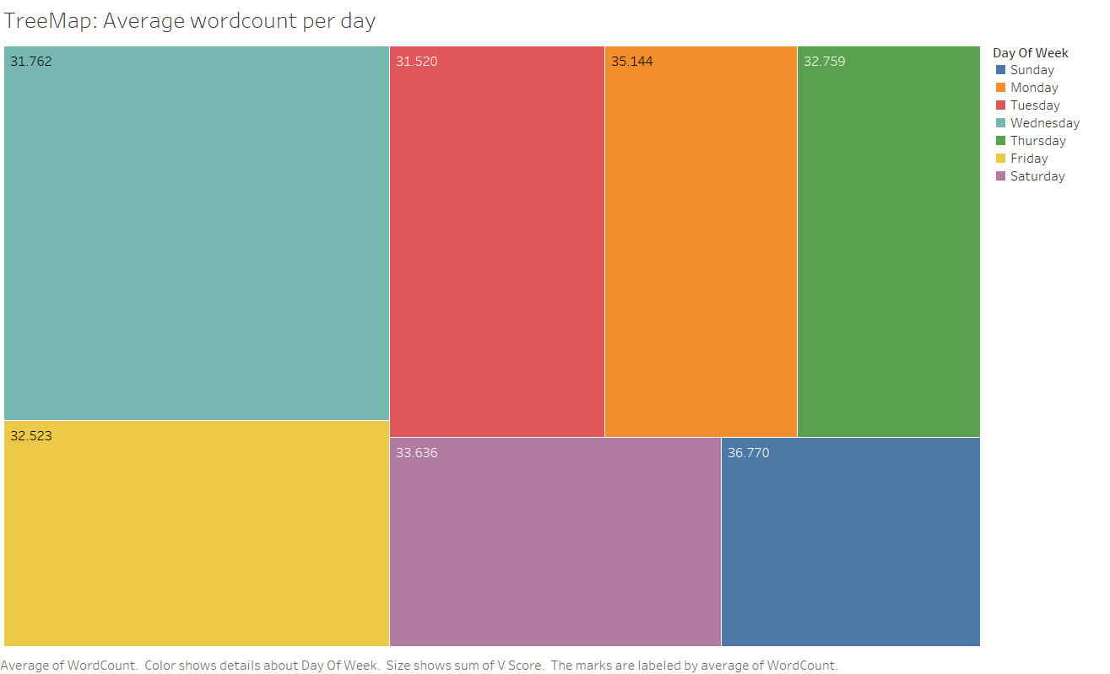

Slide 7
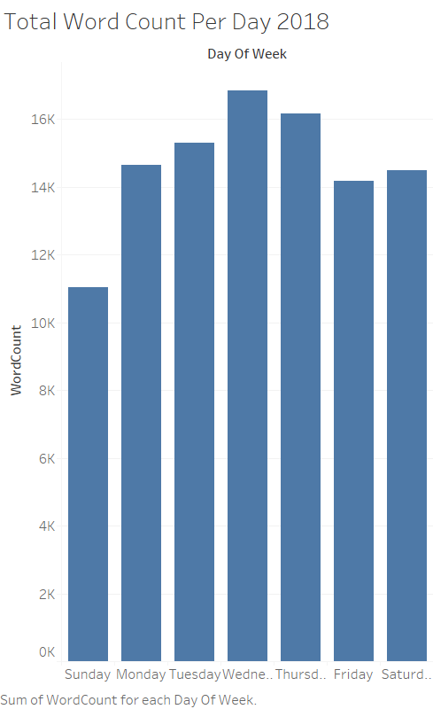

Slide 8
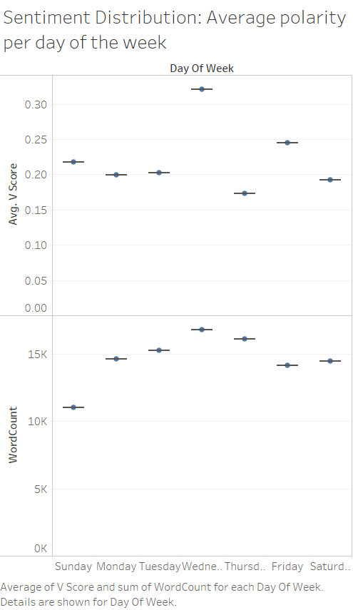

Slide 9
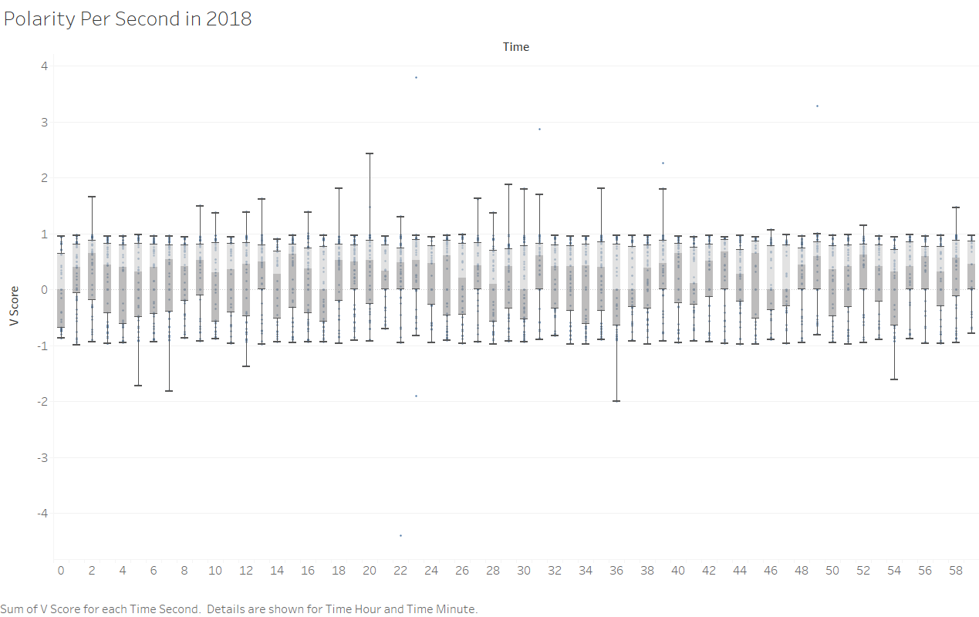

Slide 10
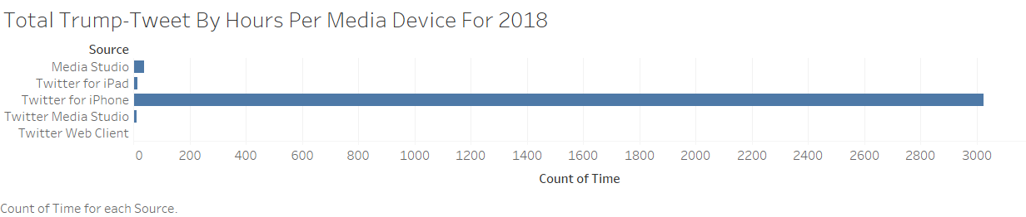

Slide 11
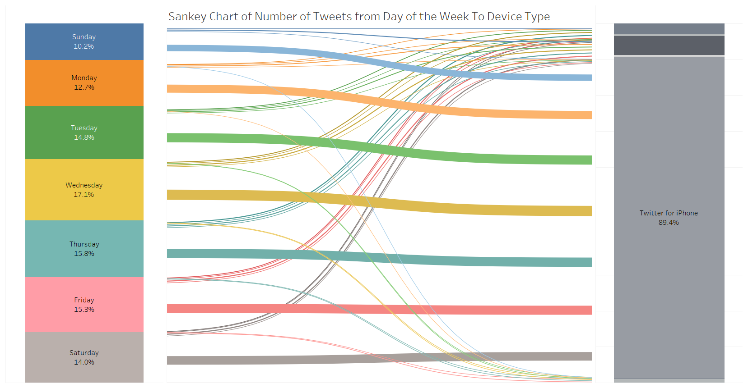

Slide 12
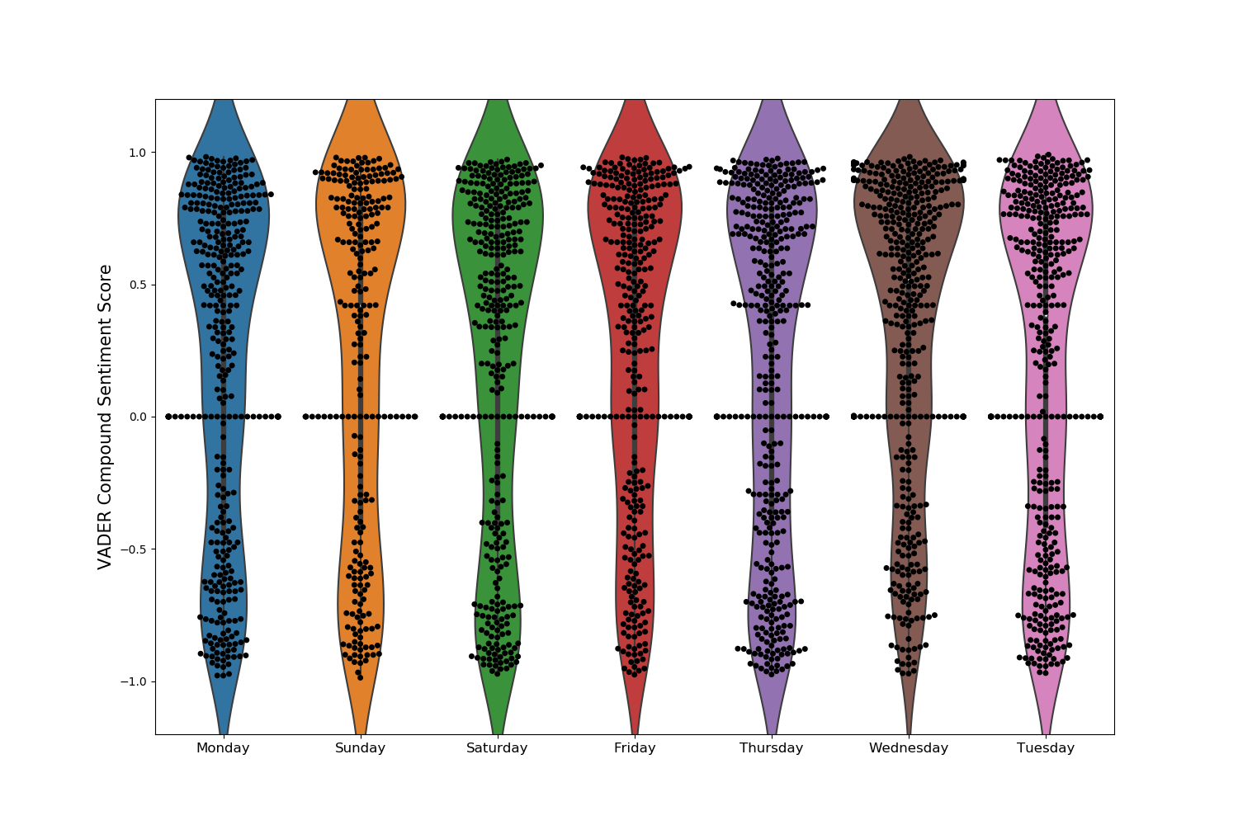
VADER Compound Sentiment Score ( Weekly - 2018)

Slide 13
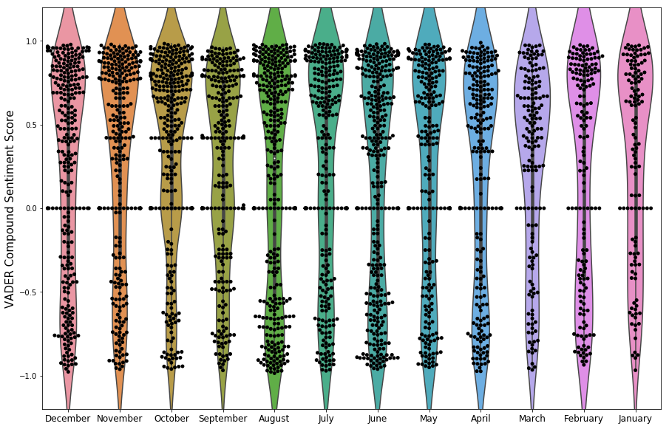
VADER Compound Sentiment Score ( Monthly-2018)

Slide 14

Word Cloud

Slide 15
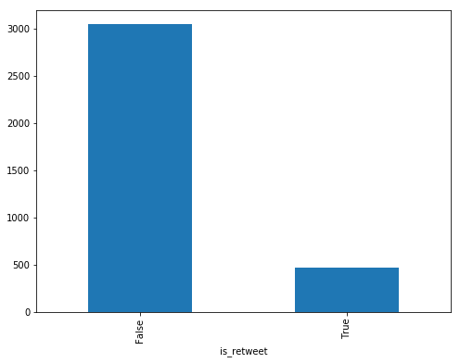
Re-tweet sentiment analysis

Slide 16
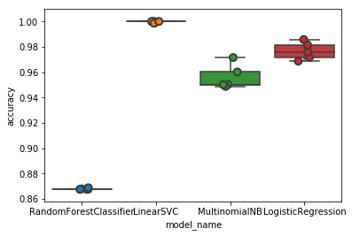
Model Analysis

Slide 17
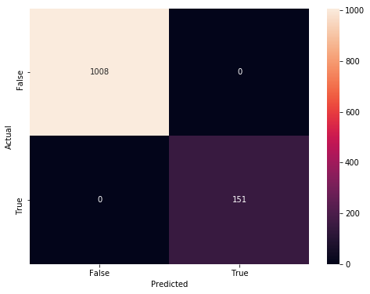
Confusion Matrix for the re-tweet

Slide 18
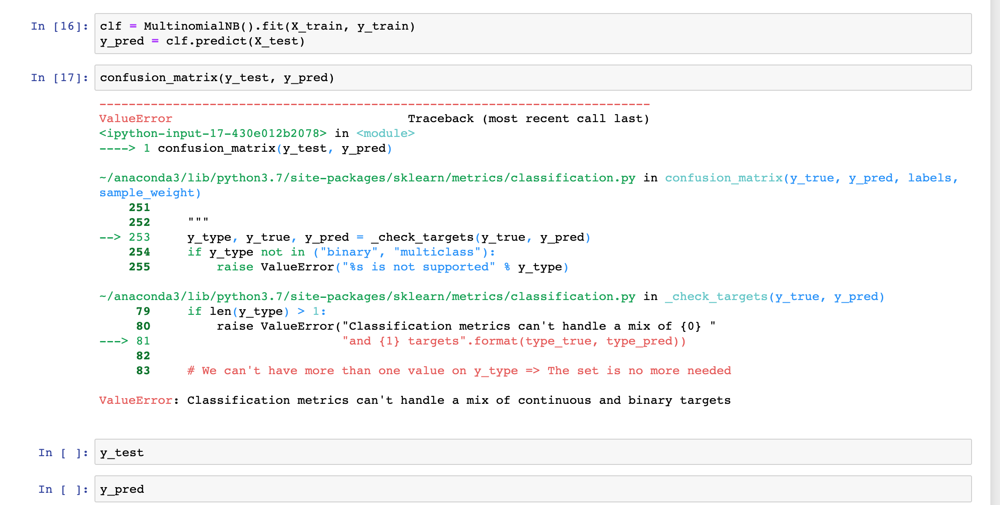
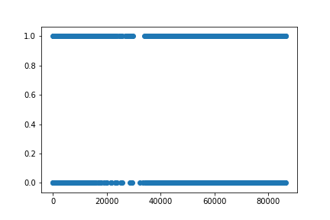
Lack of Dimensions to make models work.
Confusion Matrix Fail
Linear Regression Fail

Slide 19
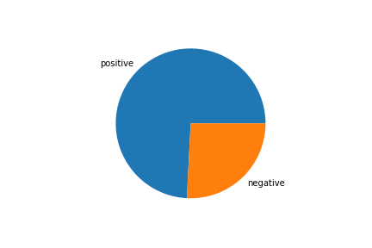
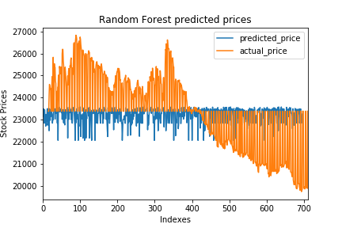
STOCK PREDICTION USING TRUMP TWITTER SENTIMENT ANALYSIS (2017-18)
Pie chart showing positive and negative tweets
Predicted DOW Price Vs Actual Price

Slide 20
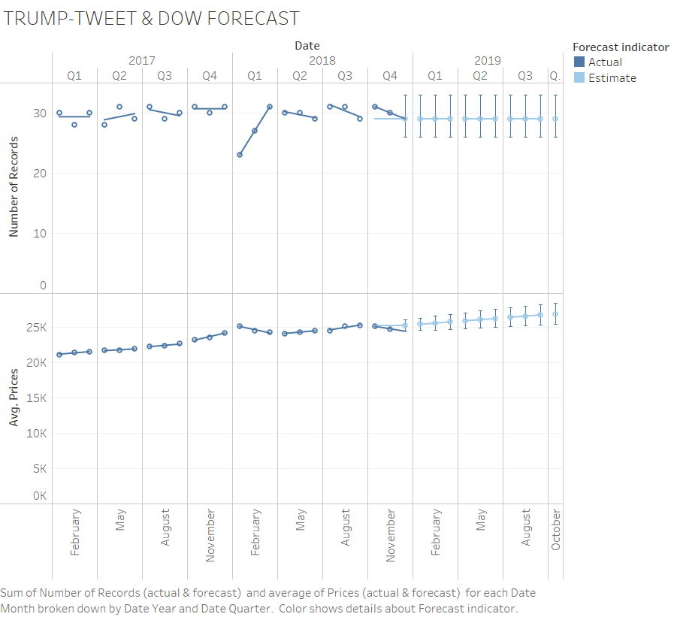
Notes:
Trend Lines Model
A linear trend model is computed for average of Prices (actual & forecast) given Date Month. The model may be significant at p <= 0.05. The factor Forecast indicator may be significant at p <= 0.05. The factor Quarter of Date may be significant at p <= 0.05. The factor Year of Date may be significant at p <= 0.05.
Model formula:
Forecast indicator*Quarter of Date*Year of Date*( Month of Date + intercept )
Number of modeled observations:
34
Number of filtered observations:
0
Model degrees of freedom:
24
Residual degrees of freedom (DF):
10
SSE (sum squared error):
120327
MSE (mean squared error):
12032.7
R-Squared:
0.998769
Standard error:
109.694
p-value (significance):
< 0.0001
Analysis of Variance:
Field
DF
SSE
MSE
F
p-value
Forecast indicator
1
109931.74
109932
9.13605
0.0128386
Quarter of Date
17
1974476.4
116146
9.65247
0.0004404
Year of Date
8
38104083
4.76301e+06
395.837
< 0.0001
A linear trend model is computed for sum of Number of Records (actual & forecast) given Date Month. The model may be significant at p <= 0.05. The factor Year of Date may be significant at p <= 0.05.
Model formula:
Forecast indicator*Quarter of Date*Year of Date*( Month of Date + intercept )
Number of modeled observations:
34
Number of filtered observations:
0
Model degrees of freedom:
24
Residual degrees of freedom (DF):
10
SSE (sum squared error):
9.83333
MSE (mean squared error):
0.983333
R-Squared:
0.870664
Standard error:
0.991632
p-value (significance):
0.040611
Analysis of Variance:
Field
DF
SSE
MSE
F
p-value
Forecast indicator
1
-1.7763568e-15
-1.776e-15
-1.806e-15
N/A
Quarter of Date
17
37.985781
2.23446
2.27233
0.094151
Year of Date
8
26.22619
3.27827
3.33384
0.0392629

Slide 22

Observation
We were able to show correlation between number of tweets and sentiment.
More tweets with larger word counts trended towards more positive sentiment in those tweets.
Activity on twitter trended towards increasing in the middle of the week and at the end of the year.
I-phone was the most preferred device.
Bag of words technique seemed to highlight more negative phrases being used.

Slide 23
Conclusion
There would need to be more exploration into sentiment to make sure the vader scores are in alignment with the word frequency identified in the word cloud.
Our datasets and questions need to be modified to include more dimensions in order to generating results from machine learning.

Slide 24

THANK YOU !
This Photo by Unknown Author is licensed under CC BY-SA

